Slide 1
Similarity in Quora questions
By:
Tirth Kothari
Soham Kulkarni

Slide 2

Introduction:
As we already talked before regarding our problem in searching the solution of our doubts online due to duplicity of questions.
We are basically working on similarity in Quora questions.
Objective:
To watchout for the similar questions asked in Quora and identify them using the models like linear SVM, logistic regression, etc.

Slide 3
Background Work
A Comparative Analysis of Text Similarity Measures and Algorithms in Research Paper Recommender System, by Maake Benard Magara, Sunday O. Ojo from Tshwane Institute of Technology and Tranos Zuva from Vaal University of Technology.
Efficient estimation of word representations in vector space, by T. Mikolov, K. Chen, G. Corrado and J. Dean
[1]
[2]

Slide 4
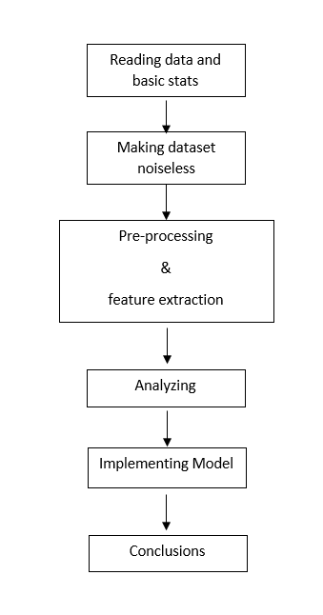
Project-flow:

Slide 5
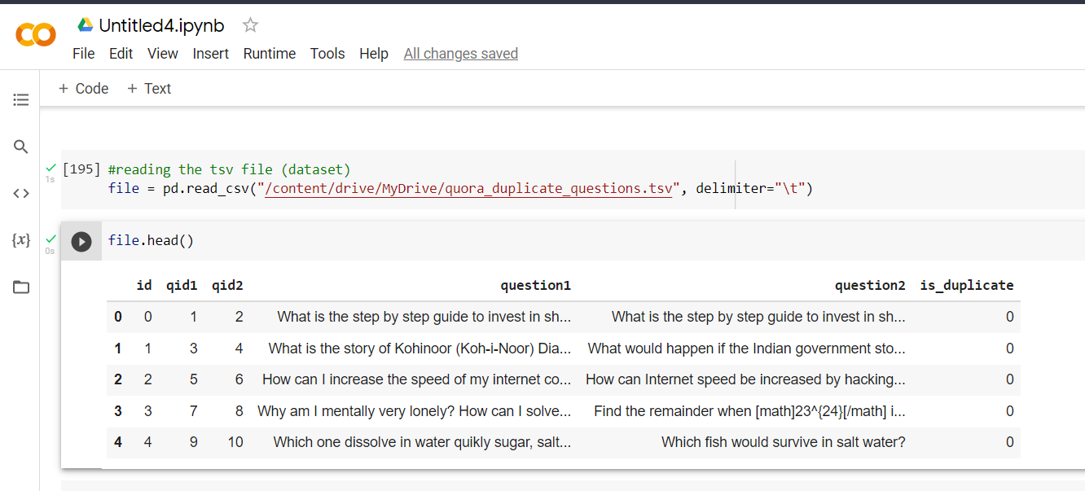
Dataset

Slide 6
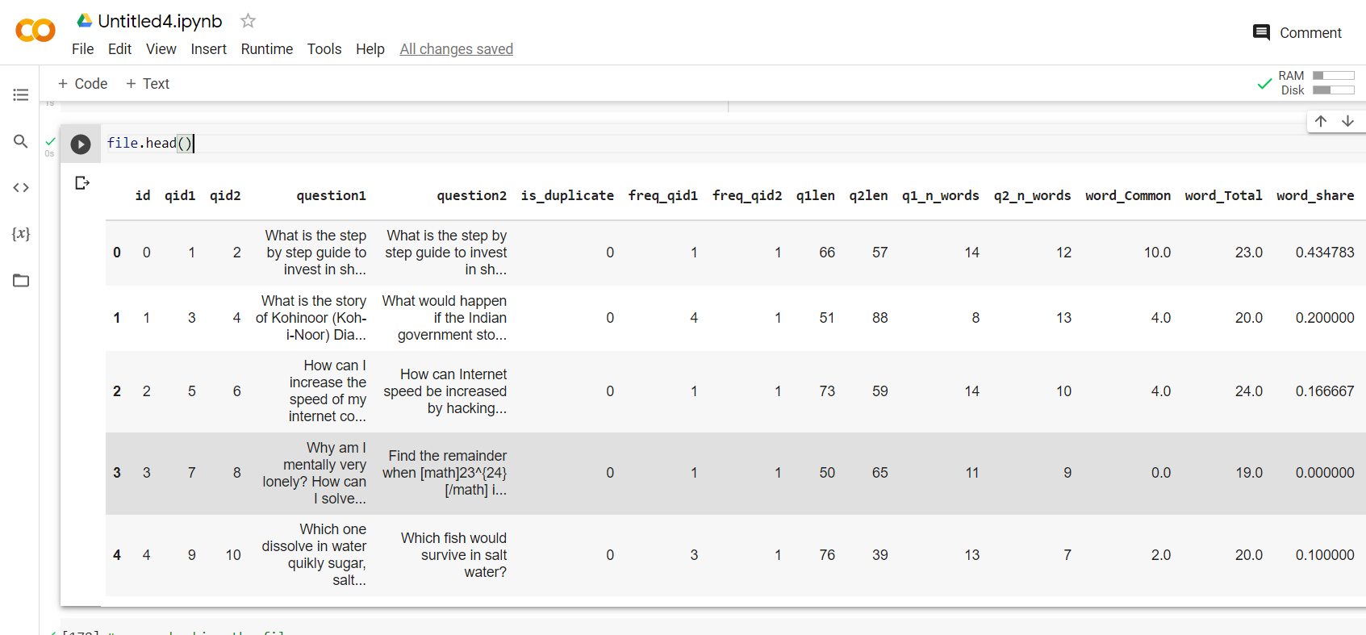
Updated dataset for training:

Slide 7
Further processing:
Converting text to numeric form
Many options: Word2Vec, TF-IDF, BOW, etc.
According to some research and experiments, TF-IDF was proved to be the king of speed in processing and was also giving almost accurate results.
So on the basis of overall performance, TF-IDF was proved to be good among all.
[3]

Slide 8
Models used

Slide 9
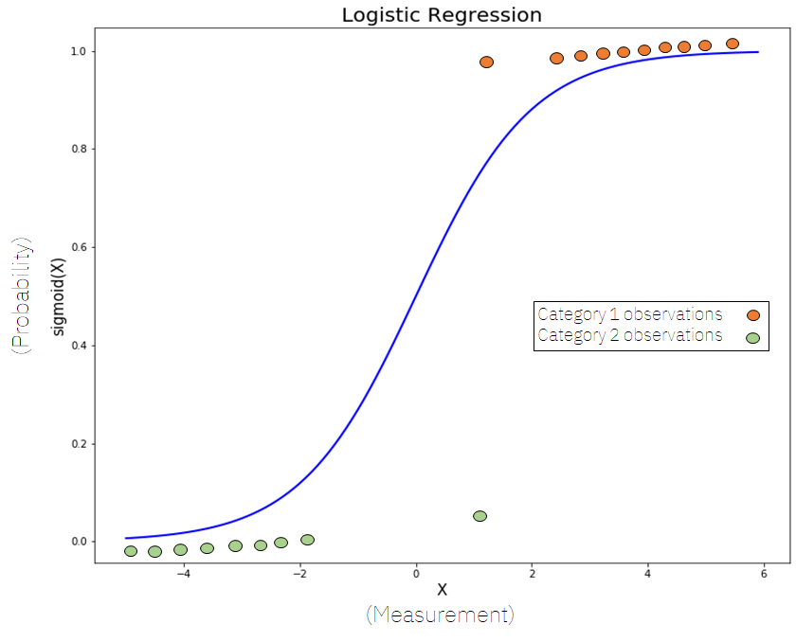
Logistic regression:
It is used to solve the binary classification problem.
All input features are calculated and reflected in dataset.
Uses weighted combination of input features and passes them through a sigmoid function.
Sigmoid function converts into value either 0 OR 1.
[4]

Slide 10
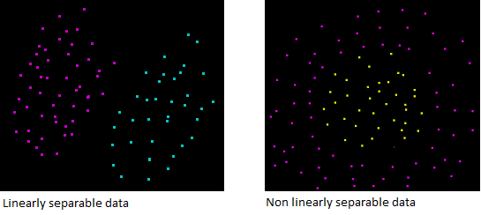
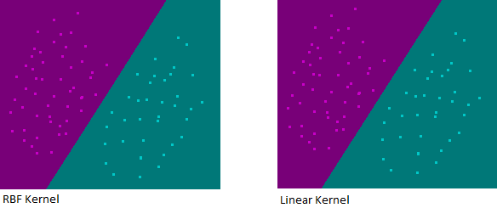
Linear SVM:
Most of text classification problems are linearly separable [5] (Thorsten Joachims Universit at Dortmund)
The linear kernel is good when there is a lot of features. That's because mapping the data to a higher dimensional space does not really improve the performance.
In text classification, both the numbers of instances (document) and features (words) are large.
the image 2, the decision boundary produced by a RBF kernel when the data is linearly separable is almost the same as the decision boundary produced by a linear kernel. Mapping data to a higher dimensional space using an RBF kernel was not useful.
Image : 1 [6]
Image : 2 [6]

Slide 11
Xg-boost:
XGBoost is the name of a machine learning method. It can help you to predict any kind of data if you have already predicted data before. You can classify any kind of data. It can be used for text classification too.
The XGBoost is having a tree learning algorithm as well as linear model learning, and because of that, it is able to do parallel computation on a single machine. This makes it 10 times faster than any of the existing gradient boosting algorithms.
Gradient Boosting is an ensemble learner like Random Forest algorithm.
This means it will generate a final model based on a combination of individual models.
The predictive capability of these single different models is inadequate and likely to overfitting but coupling many such weak single models in an ensemble will lead to a better result. In Gradient Boosting machines, the most popular type of weak model used is decision trees - another parallel to Random Forests.

Slide 12
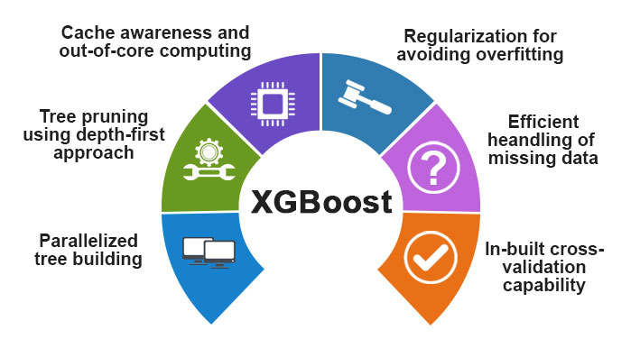
XG-BOOST Features
[7]

Slide 13
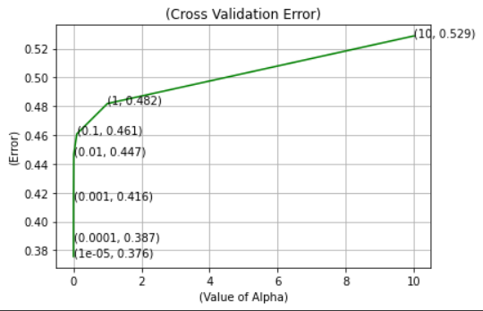
Results:
Logistic regression.

Slide 14
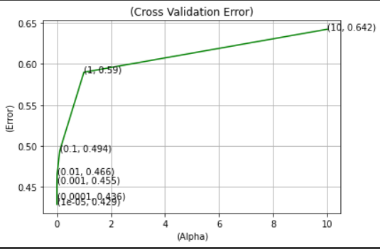
Linear SVM:
XG-Boost:

Slide 15
Conclusion:
Models name | Test log loss
Logistic regression | 0.376
Linear SVM | 0.429
XG-Boost | 0.348

Slide 16
Future scope:
Creating a user interface for text similarity, as we now came to know regarding the best model.
Make model more accurate using features, different methods for weighted vectors, etc.
Using this, merge the similar questions and map all the answers to all the questions in the same group.

Slide 17
Tasks:
Soham Kulkarni: literature review, data preprocessing, implementing linear SVM, XG-Boost, Final report and Presentation slides.
Tirth Kothari: data preprocessing, Feature extraction, implementing Logistic regression, XG-Boost, Final report and Presentation slides.

Slide 18
References:
[1] https://ieeexplore.ieee.org/document/8368766
[2]https://www.researchgate.net/publication/234131319_Efficient_Estimation_of_Word_Representations_in_Vector_Space
[3] https://medium.datadriveninvestor.com/tf-idf-for-similarity-scores-391c3c8788e8
[4] https://towardsdatascience.com/logistic-regression-explained-9ee73cede081
[5] http://www.cs.cornell.edu/people/tj/publications/joachims_98a.pdf
[6] https://www.svm-tutorial.com/2014/10/svm-linear-kernel-good-text-classification/
[7] https://www.educba.com/xgboost-algorithm/

